Slide 1
IT457 – Cloud Computing

Slide 2
Course Information
Grading Scheme
Mid-sem exam – 40%
End-sem exam – 40%
Labs – 20%
*subject to online exam system working well

Slide 3
Course Information
Course Plan
Cloud Computing – Developer perspective
Cloud Computing – Architect perspective
Cloud Computing – IT perspective
Cloud Service Providers
Azure
References
Online material (like here, here and here).
No single reference book

Slide 4

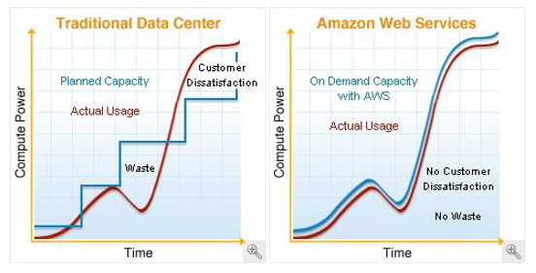
Cloud Computing
BUILDING BLOCKS
Definition
“Cloud computing is a specialized form of distributed computing that introduces utilization models for provisioning and measured resources
Business Drivers (i.e. motivation)
Capacity Planning
Cost Reduction
Organizational Agility
remotely
scalable
and platform services
”.
Organizational agility is the measure of an organisation’s responsiveness to change.
IT enterprise needs to respond to business change by scaling its IT resources beyond what was predicted or planned.
New business requirement for IT resources to be more available & reliable than before.
Budget constrains scales down up-front investments in IT and makes it vulnerable to such risks.
IT support of new and expanded business automations an ever-increasing investment
Two costs need to be accounted for:
Cost of acquiring new infrastructure
Operational / maintenance cost
Operational overhead represents for large share of IT budgets
Operation overheads – technical manpower, upgrades & patches, utility bills – power & cooling, security & access control, administrative & accounting (licensing etc.)
Lead Strategy – adding capacity to an IT resource in anticipation of demand.
Lag Strategy – adding capacity when the IT resource reaches full capacity
Match Strategy – adding IT resource capacity in small increments as demand increases.
Problems:
Accommodate Max Load – over expenditure
Moderating expenditure – transaction losses & usage limitations.
Notes:
Capacity planning – irctc tatkal booking overload. Add capacity by increasing servers – un/underutilized during non-peak hours.
Cost – acquiring new infra & ongoing / maintenance cost

Slide 5
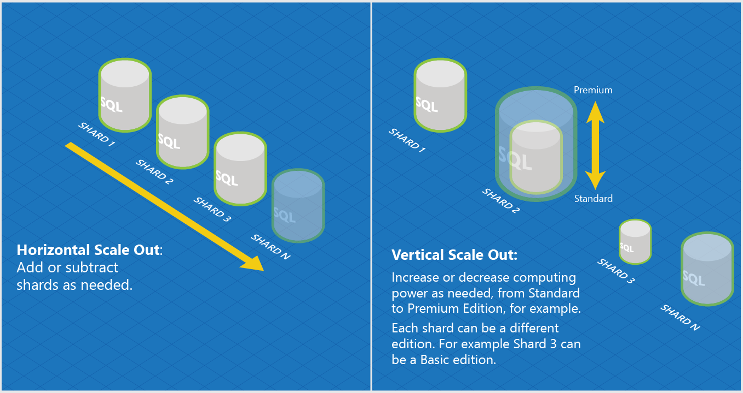
Basic Concepts & Terminologies
BUILDING BLOCKS
Cloud (same as internet?)
IT Resource
On-Premise
Cloud Consumers & Cloud Providers
Scaling
Vertical (Scale Up)
Horizontal (Scale Out)
Cloud Service
Cloud Service Consumer

Slide 6
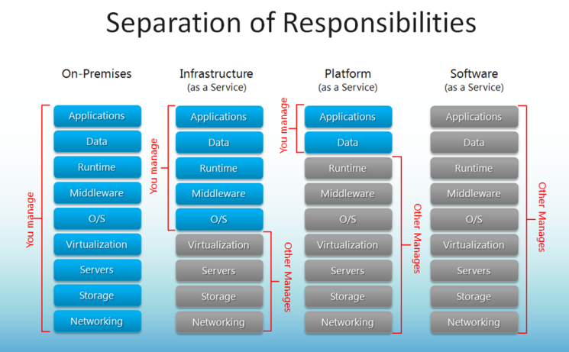
Cloud Delivery Models
BUILDING BLOCKS
IaaS – Infrastructure as a Service
PaaS – Platform as a Service
SaaS – Software as a Service
Combining Cloud Delivery Models
Notes:
Is website in old days a SaaS?

Slide 7
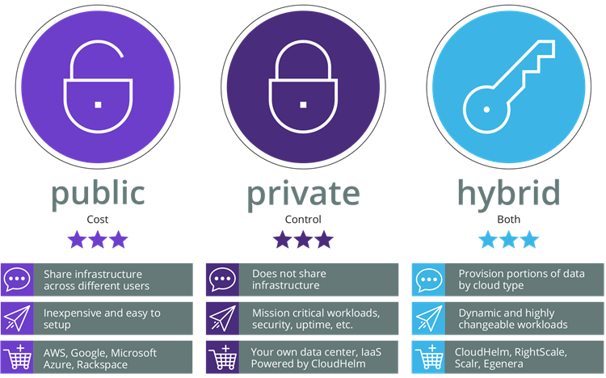
Cloud Deployment Models
BUILDING BLOCKS
Public Cloud
Private Cloud
Hybrid Cloud
Community Cloud

Slide 8
Cloud vs Traditional
Traditional (on-premises) Systems
Cloud based Systems
Monolithic, centralised
Design for predictable scalability
Relational database
Strong consistency
Serial and synchronised processing
Design to avoid failures (MTBF)
Occasional big updates
Manual management
Snowflake servers
Deconstructed, decentralised
Design for elastic scale
Polyglot persistence (mix of storage technologies)
Eventual consistency
Parallel and asynchronous processing
Design for failure (MTTR)
Frequent small updates
Automated self-management
Immutable infrastructure

Slide 9
Cloud Provider – AWS
BUILDING BLOCKS
Amazon Web Services
AWS World
AWS Organizations
AWS Account
AWS Account
OU: Admins
SCP: Admin
AWS Account
OU: Dev
AWS Account
AWS Account
AWS Account (Master)
SCP: DevTest
AWS Company Account
OU: Test
AWS Account
AWS Account
Notes:
SCP – Service Control Policy

Slide 10



AWS – IAM vs Organizations
BUILDING BLOCKS
IAM (Identity and Access Management)
Organizations
AWS Account
Root A/C
AWS Account
Test Policy
Dev Policy
Test SCP
Dev SCP
Billing & Usage
Test Team
Dev Team
Test OU
Dev OU
AWS A/C
AWS A/C
Organization
Groups
Prod OU
Prod Team
AWS A/C
Prod Policy
Prod SCP

Slide 11
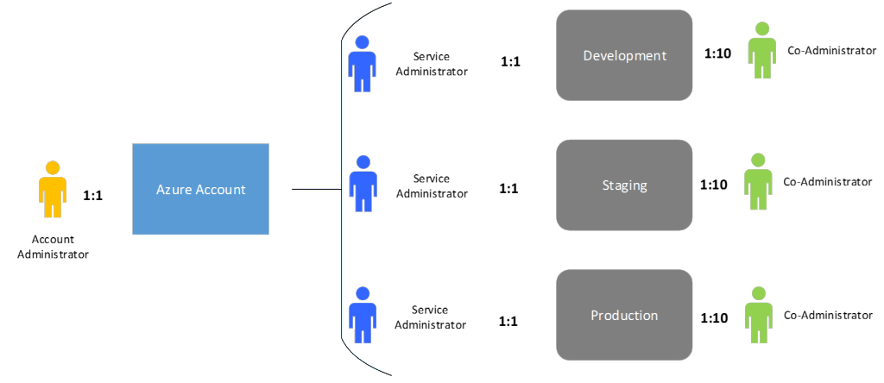
Cloud Provider – Azure
BUILDING BLOCKS
Azure World
<id>@Hotmail.com; <id>@outlook.com; <id>@live.com;
Used for accessing various Microsoft services.
Subscriptions
$
Microsoft Account
$
Organizational Account
$
<id>@<org name>.onmicrosoft.com => Gives a unique domain for accessing Azure services for the org.

Slide 12
Data Centres Technology - AWS
BUILDING BLOCKS
Global scope (eg. AWS Account)
Amazon Web Services
Region
Regional scope (eg. EC2 Instance ID)
Regions are completely isolated from other regions
Greatest possible fault tolerance & stability
Will not replicate resource across regions automatically
Charge for data transfer across regions
Availability Zone
Region
Zone scope (eg. EC2 Instance)
Availability Zone maps to one or more physical data centre (facility) of Amazon.
AZs are connected to each other with fast, private FO networking.
Distribute instances across AZs for continuity of application.
Availability Zone
Availability Zone
dc
dc
Availability Zone
Availability Zone
Notes:
1. Resources viewable only by region.
2. AZs have to be chosen, either by user or by AWS.
3. Distribute instances across multiple Azs, one fails – redirect to another. Design app such a way.
4. AZ 3 letter identifier us-east-1a. Location of us-east-1a may not be same for two accounts
5. Constrained Azs, removed Azs. Azs in two accounts could be different.

Slide 13
Data Centre Technology - Azure
BUILDING BLOCKS
Azure
Storage data is triplicated in region and it’s paired region
Availability set is created by user. SLA of 99.95% holds only if two or more VMs are put in an AvSet.
Fault Domains – up to 3 per AvSet.
Update Domains – up to 5 (20 via RM) per AvSet.
Azure Region
Azure Region
Location
Location (dc, hardware cluster)
> 480 Km
FD 0
FD 1
FD 2
VM1
VM2
VM3
Availability Set
VM4
VM5
VM6
Azure Region
(Paired)
Same Update Domain
VM7
VM8

Slide 14
Quiz time!
BUILDING BLOCKS
Q. The SQL database instance in cloud is throttling. I move it from Standard tier to Premium tier. This move is an example of Horizontal or Vertical scaling?
A. Vertical scaling.
Q. I need to create my resume for placement interviews. I run MS Word online through Office 365 subscription to create my resume. This is an example of IaaS/PaaS/SaaS?
A. SaaS.
Q. I provisioned (created) an VM instance in my AWS cloud for installing a web server. This is an example of IaaS/PaaS/SaaS?
A. IaaS
Q. My company has multiple AWS accounts for running its business in AWS cloud. So many accounts are causing access and tracking confusions. My boss just asked me to look for a solution in AWS. What is that solution?
A. Use AWS organizations to create OUs & assign SCPs and make one AWS account as master account for that organization. The billing then will happen against that master AWS account.
Q. In Azure, an Azure subscription can have multiple Azure accounts. True or false?
A. False. An Azure account can have multiple subscriptions but not vice versa.
Q. In Azure, I create my Azure account and then created a VM under it. All good. True or False?
A. False. Without first creating a subscription, no resources can be created under an Azure account.

Slide 15
Exercise
For a web application, following are the resources that you are creating in Azure: Two servers, S1 & S2, for serving HTTP requests, two data base servers Db1 and Db2 for the databases and B1 & B2 servers for
processing back-end/business jobs for the service. How will you distribute these machines in availability sets, fault and upgrade domains to make a system resilience to failure?

Slide 16
Resource Management in Azure
Azure Resource Manager is the deployment and management service for Azure.
It provides a management layer that enables you to create, update, and delete resources in your Azure account.
You use management features, like access control, locks, and tags, to secure and organize your resources after deployment.

Slide 17
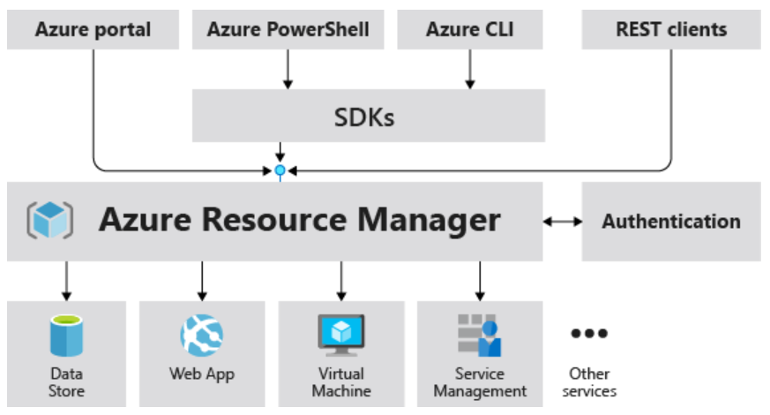
Consistent management layer
When a user sends a request from any of the Azure tools, APIs, or SDKs, Resource Manager receives the request.
When a user sends a request from any of the Azure tools, APIs, or SDKs, Resource Manager receives the request.

Slide 18
Terminology
resource - A manageable item that is available through Azure. Virtual machines, storage accounts, web apps, databases, and virtual networks are examples of resources. Resource groups, subscriptions, management groups, and tags are also examples of resources.
resource group - A container that holds related resources for an Azure solution. The resource group includes those resources that you want to manage as a group.
resource provider - A service that supplies Azure resources. For example, a common resource provider is Microsoft.Compute, which supplies the virtual machine resource. Microsoft.Storage is another common resource provider.
Resource Manager template - A JavaScript Object Notation (JSON) file that defines one or more resources to deploy to a resource group, subscription, management group, or tenant. The template can be used to deploy the resources consistently and repeatedly.

Slide 19
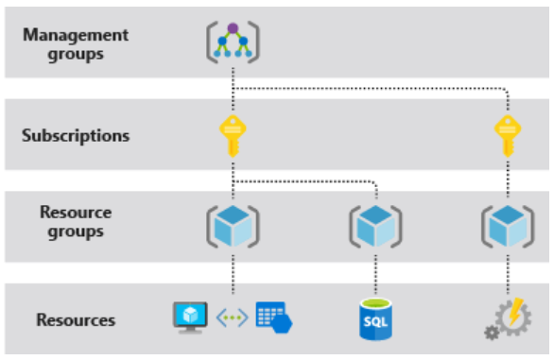
Understand scope
Azure provides four levels of scope: management groups, subscriptions, resource groups, and resources.
You apply management settings at any of these levels of scope
Lower levels inherit settings from higher levels.

Slide 20
Resource groups
All the resources in your resource group should share the same lifecycle. You deploy, update, and delete them together. If one resource, such as a server, needs to exist on a different deployment cycle it should be in another resource group.
Each resource can exist in only one resource group.
The resources in a resource group can be located in different regions than the resource group.
When creating a resource group, you need to provide a location for that resource group.
A resource group can be used to scope access control for administrative actions.
A resource can connect to resources in other resource groups. This scenario is common when the two resources are related but don't share the same lifecycle. For example, you can have a web app that connects to a database in a different resource group.
When you delete a resource group, all resources in the resource group are also deleted.
Some resources can exist outside of a resource group. These resources are deployed to the subscription, management group, or tenant. Only specific resource types are supported at these scopes.

Slide 21
AZURE AUTOMATION USING AZ CLI

Slide 22
az cli
The CLI is a tool designed to get you working quickly and efficiently with Azure services, with an emphasis on automation
Works on Windows, Mac OS, Linux
Can also be run in Azure portal as cloud shell
Sign In
az login

Slide 23
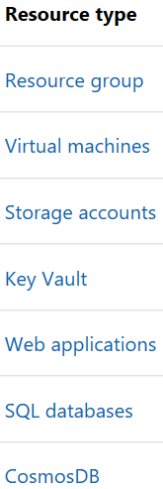
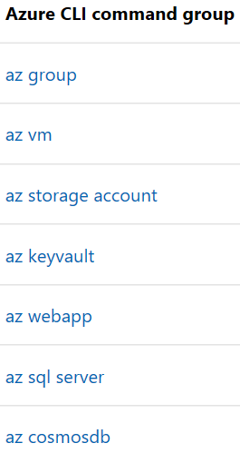
Common Commands
Commands in the CLI are organized as commands of groups.
Each group represents an Azure service, and commands operate on that service.

Slide 24
Globally available arguments
--help prints CLI reference information about commands and their arguments and lists available subgroups and commands.
--output changes the output format. The available output formats are json, jsonc (colorized JSON), tsv (Tab-Separated Values), table (human-readable ASCII tables), and yaml. By default the CLI outputs json. To learn more about the available output formats, see Output formats for Azure CLI.
--query uses the JMESPath query language to filter the output returned from Azure services. To learn more about queries, see Query command results with Azure CLI and the JMESPath tutorial.
--verbose prints information about resources created in Azure during an operation, and other useful information.
--debug prints even more information about CLI operations, used for debugging purposes. If you find a bug, provide output generated with the --debug flag on when submitting a bug report.

Slide 25
Creating a virtual machine using az cli
az login
In Azure, all resources are allocated in a resource management group.
Resource groups provide logical groupings of resources that make them easier to work with as a collection.
Create a resource group
az group create –name mscitrg –location centralindia
Create a vm under resource group
az vm create --resource-group mscitrg --name testvm1 --image ubuntults --admin-user lavneetsingh --generate-ssh-keys --verbose --output json

Slide 26
az vm show --name testvm1 --resource-group mscitrg
az group delete --name mscitrg --no-wait
az group wait --name mscitrg --deleted

Slide 27
Infrastructure as Code
With the move to the cloud, many teams have adopted agile development methods. These teams iterate quickly
They need to repeatedly deploy their solutions to the cloud, and know their infrastructure is in a reliable state
As infrastructure has become part of the iterative process, the division between operations and development has disappeared
Teams need to manage infrastructure and application code through a unified process (DevOps)

Slide 28
To meet these challenges, you can automate deployments and use the practice of infrastructure as code.
In code, you define the infrastructure that needs to be deployed. The infrastructure code becomes part of your project.
Just like application code, you store the infrastructure code in a source repository and version it.
Any one on your team can run the code and deploy similar environments.

Slide 29
ARM Templates – Infrastructure as Code in Azure
The template is a JavaScript Object Notation (JSON) file that defines the infrastructure and configuration for your project.
In the template, you specify the resources to deploy and the properties for those resources.
Hello World template:
{
"$schema": "https://schema.management.azure.com/schemas/2019-04-01/deploymentTemplate.json#",
"contentVersion": "1.0.0.0",
"resources": []
}

Slide 30
Template files
Within your template, you can write template expressions that extend the capabilities of JSON. These expressions make use of the functions provided by Resource Manager.
The template has the following sections:
Parameters - Provide values during deployment that allow the same template to be used with different environments.
Variables - Define values that are reused in your templates. They can be constructed from parameter values.
User-defined functions - Create customized functions that simplify your template.
Resources - Specify the resources to deploy.
Outputs - Return values from the deployed resources.
Notes:
https://docs.microsoft.com/en-us/azure/azure-resource-manager/templates/template-tutorial-create-first-template?tabs=azure-powershell

Slide 31
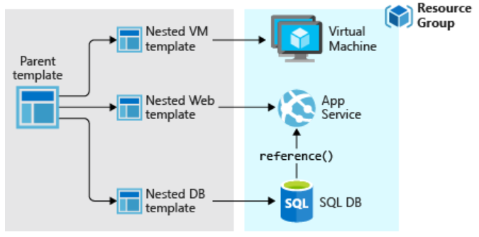
Template Design
You don't have to define your entire infrastructure in a single template.
Often, it makes sense to divide your deployment requirements into a set of targeted, purpose-specific templates
To deploy a particular solution, you create a master template that links all the required templates.

Slide 32
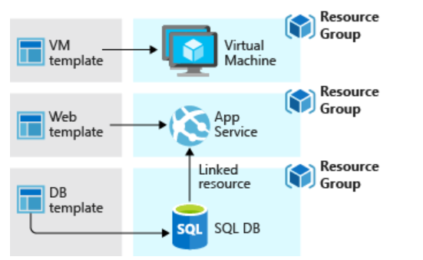
If you envision your tiers having separate lifecycles, you can deploy your three tiers to separate resource groups.
The resources can still be linked to resources in other resource groups

Slide 33
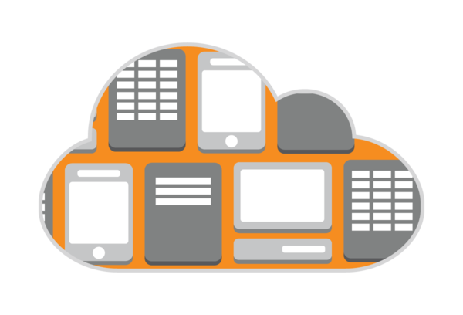
Cloud Architectures

Slide 34
N-Tier
Traditional layered
Higher layer calls lower ones, not vice-versa
Web-Queue-Worker
Purely PaaS
Microservices
Many small independent services
Event-driven Architecture
Can be a liability – not easy to update individual components
Suitable for app migration
Generally IaaS
Web FE + Worker BE
FE <-> BE communication through async msg Q
Suitable for simple domains
Services are loosely coupled
Communicate through API contracts
Uses pub-sub model
Pubs & Subs are independent
Suitable for apps that ingest large volume of data
Suitable when subsystems need to perform different actions on same data
Big Data Big Compute
Specialized architecture that fit certain profiles
Divides large datasets into chunks, parallel process and analysis

Slide 35
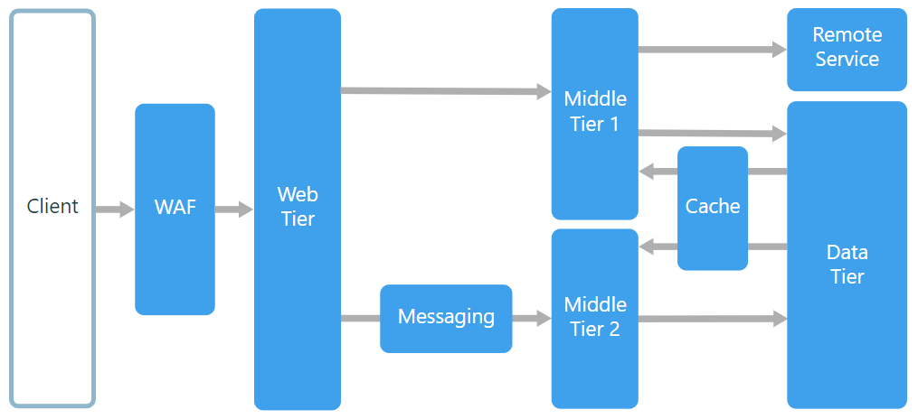
N-tier Architecture Style
An N-tier architecture divides an application into logical layers and physical tiers.
Layers are a way to separate responsibilities and manage dependencies.
Tiers are physically separated, running on separate machines.

Slide 36
When to use this architecture
Typically implemented as infrastructure-as-service (IaaS) applications, with each tier running on a separate set of VMs.
Consider an N-tier architecture for:
Simple web applications.
Migrating an on-premises application to Azure with minimal refactoring.
Unified development of on-premises and cloud applications.
Best practices
Use autoscaling to handle changes in load. See Autoscaling best practices.
Use asynchronous messaging to decouple tiers.
Cache semi static data. See Caching best practices.
Configure the database tier for high availability, using a solution such as SQL Server Always On availability groups.
Place a web application firewall (WAF) between the front end and the Internet.
Place each tier in its own subnet, and use subnets as a security boundary.
Restrict access to the data tier, by allowing requests only from the middle tier(s).

Slide 37
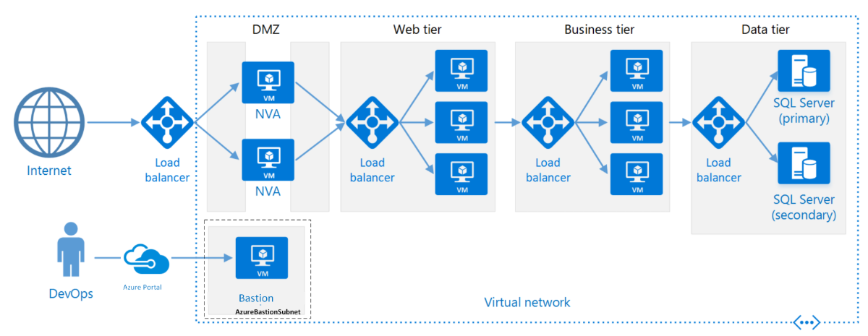
N-tier architecture on Virtual Machines

Slide 38
Each tier consists of two or more VMs, placed in an availability set or virtual machine scale set.
Multiple VMs provide resiliency in case one VM fails.
Load balancers are used to distribute requests across the VMs in a tier.
A tier can be scaled horizontally by adding more VMs to the pool.
Each tier is also placed inside its own subnet, meaning their internal IP addresses fall within the same address range.
That makes it easy to apply network security group rules and route tables to individual tiers.
The web and business tiers are stateless. Any VM can handle any request for that tier. The data tier should consist of a replicated database.
Network security groups restrict access to each tier. For example, the database tier only allows access from the business tier.

Slide 39
Role of Application Gateway
Web traffic load balancer enables us to manage traffic to our web applications
Operates at application level (OSI level 7 - Application).
Traditional load balancers operate at transport layer (OSI level 4 – TCP & UDP) and route traffic based on IP address and port.
Application Gateway can route traffic based on URL
SSL termination
supports terminate encryption at gateway, so data travels un-encrypted to the backend servers. Saves overhead.
Web application firewall – protection against common exploits
Multiple site hosting, Redirection, Session affinity etc.

Slide 40
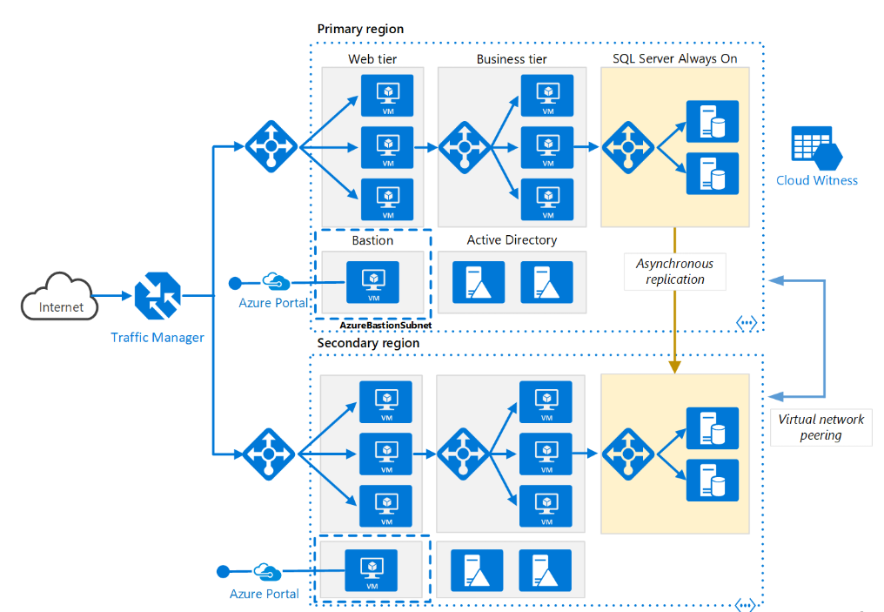
N-tier architecture – Multi-region deployment

Slide 41
Role of Traffic Manager in Multi-region deployment
Traffic Manager allows users to control traffic distribution across various application endpoints.
The Traffic Manager distributes the traffic using the configured routing method
Priority, Weighted, Performance, Geographic
Constant monitoring of the endpoint health.
Automatic failover in case the endpoints fail.
Functions at the DNS level. It uses the DNS to route clients to precise service endpoints, according to the traffic-routing rules and methods.
Traffic Manager operation modes:
Active | Passive – hot failover
Active | Passive – cold failover
Active | Active – load balanced

Slide 42
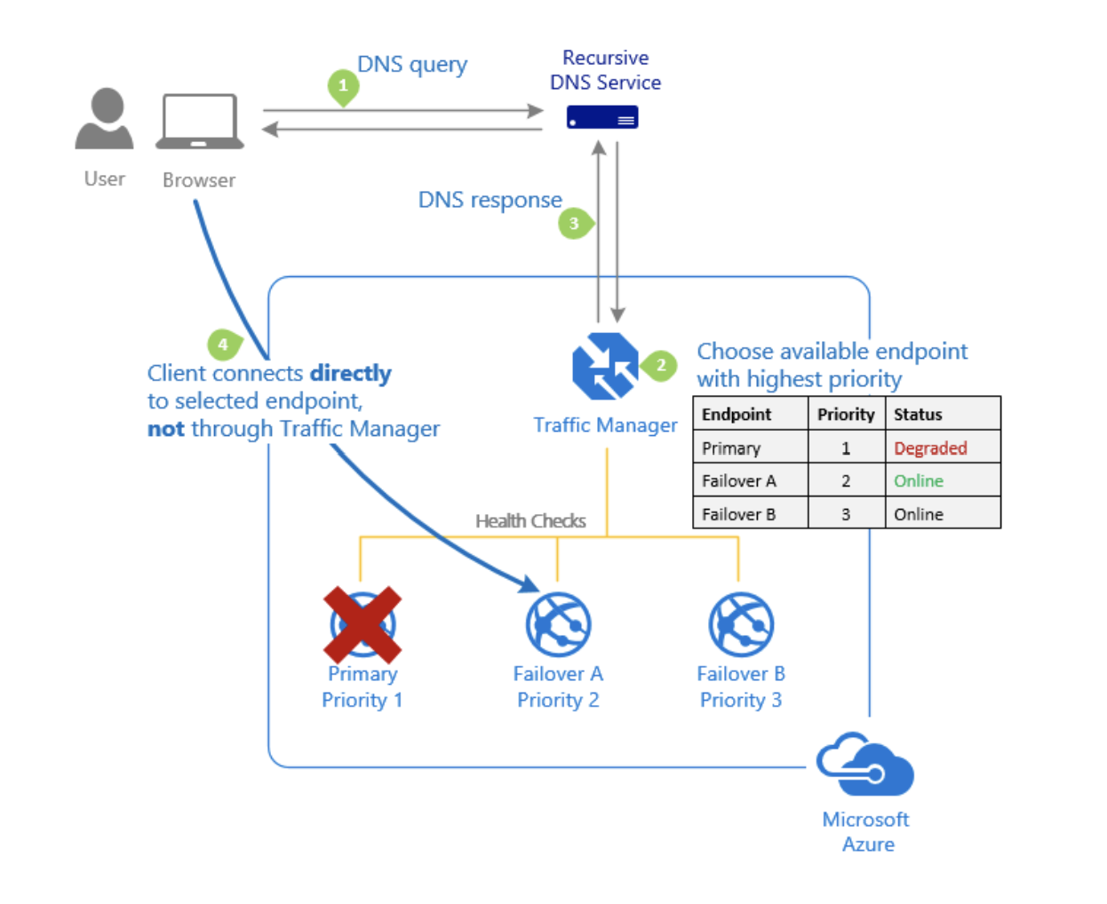
TM Routing - Priority
The 'Priority' traffic-routing method allows Azure customers to easily implement the failover pattern
By default, Traffic Manager sends all traffic to the primary (highest-priority) endpoint.
If the primary endpoint isn't available, Traffic Manager routes the traffic to the second endpoint.

Slide 43
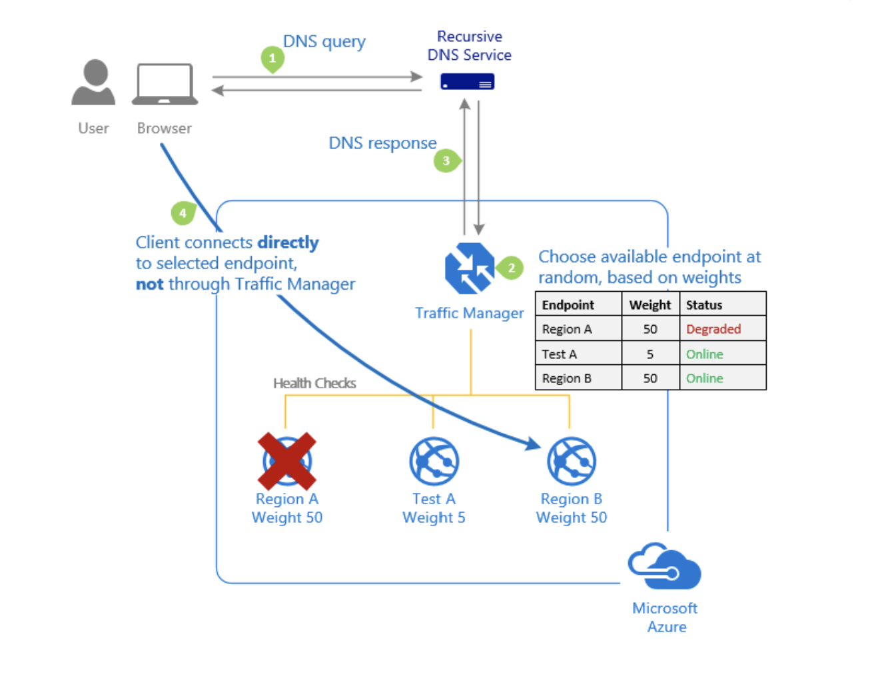
TM Routing - Weighted
Assign a weight to each endpoint in the Traffic Manager profile configuration. The weight is an integer from 1 to 1000.
For each DNS query received, Traffic Manager randomly chooses an available endpoint. The probability of choosing an endpoint is based on the weights assigned to all available endpoints.
Useful for
Gradual application upgrade
Application migration to Azure
Cloud bursting for more capacity

Slide 44
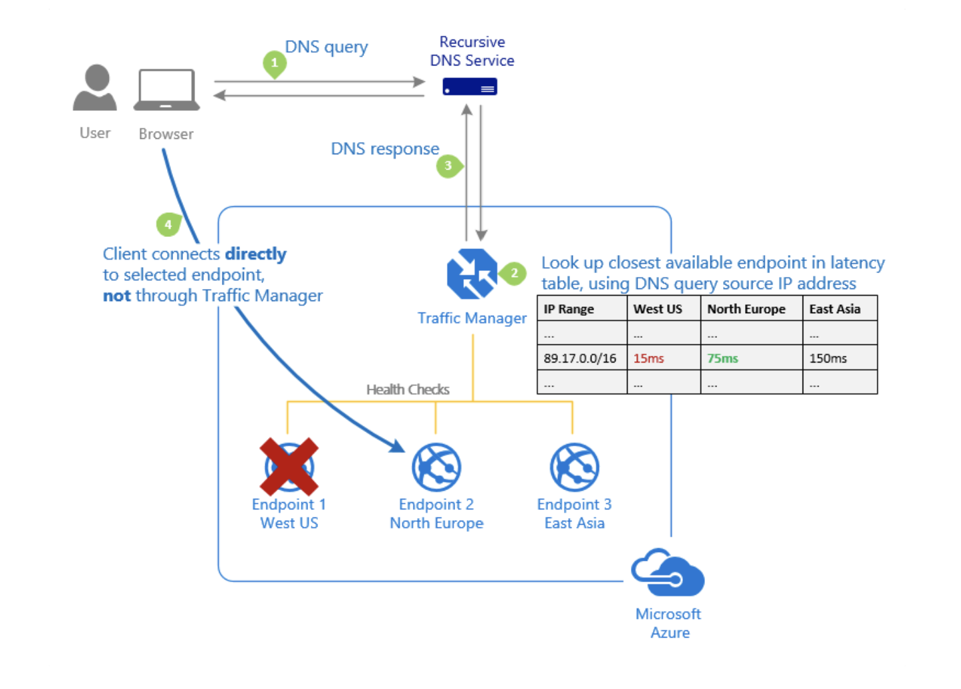
TM Routing - Performance
Traffic Manager maintains an Internet Latency Table to track the round-trip time between IP address ranges and each Azure datacenter.
'Performance' traffic-routing method determines the closest endpoint by measuring network latency.
Traffic Manager looks up the source IP address of the incoming DNS request in the Internet Latency Table. Traffic Manager then chooses an available endpoint in the Azure datacenter that has the lowest latency for that IP address range. Then Traffic Manager returns that endpoint in the DNS response.

Slide 45
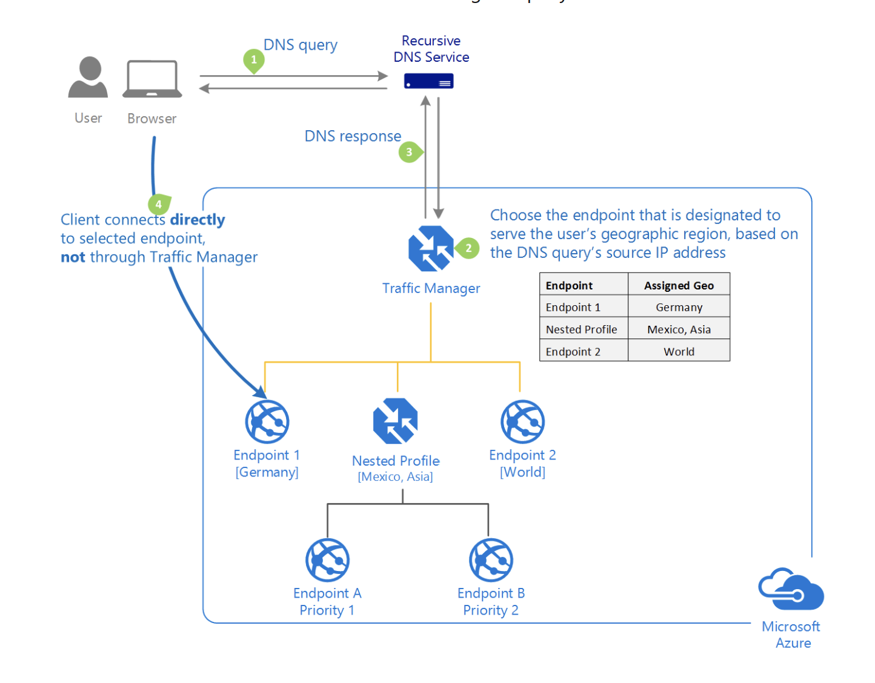
TM Routing - Geographic
Users get directed to specific endpoints: Azure, External, or Nested. Matching is based on the geographic location that the DNS query originates from.
With this routing method, it enables you to be in compliance with data sovereignty mandates, localization of content & user experience and measuring traffic from different regions.

Slide 46
TM Routing – Geographic …contd.
A geographic region can be at following levels of granularity
World, Regional grouping (e.g. Africa, Middle-east, Europe, Asia-pacific), Country/Region (India, Peru, Hong-kong), State/Province (USA-California, Australia-Qeensland)
TM Look-up starts from more specific to more general
If a user’s region is listed under two different endpoints’ geographic mapping, Traffic Manager selects the endpoint with the lowest granularity.
If a query is coming from a geographic region that has no mapping in that profile, Traffic Manager returns a NODATA response.

Slide 47
TM Routing – Nested Profiles
Each Traffic Manager profile specifies a single traffic-routing method, sometimes not sufficient
Nest Traffic Manager profiles to combine the benefits of more than one traffic-routing method
To create a nested profile, you add a 'child' profile as an endpoint to a 'parent' profile.
MinChildEndpoints
This parameter with a default value of 1 is created when you create a child profile.
Determines the minimum number of endpoints that must be available in the child profile for it to be healthy
Below this threshold, the parent profile will consider the entire child profile as unavailable, and direct traffic to the other parent profile endpoints.

Slide 48
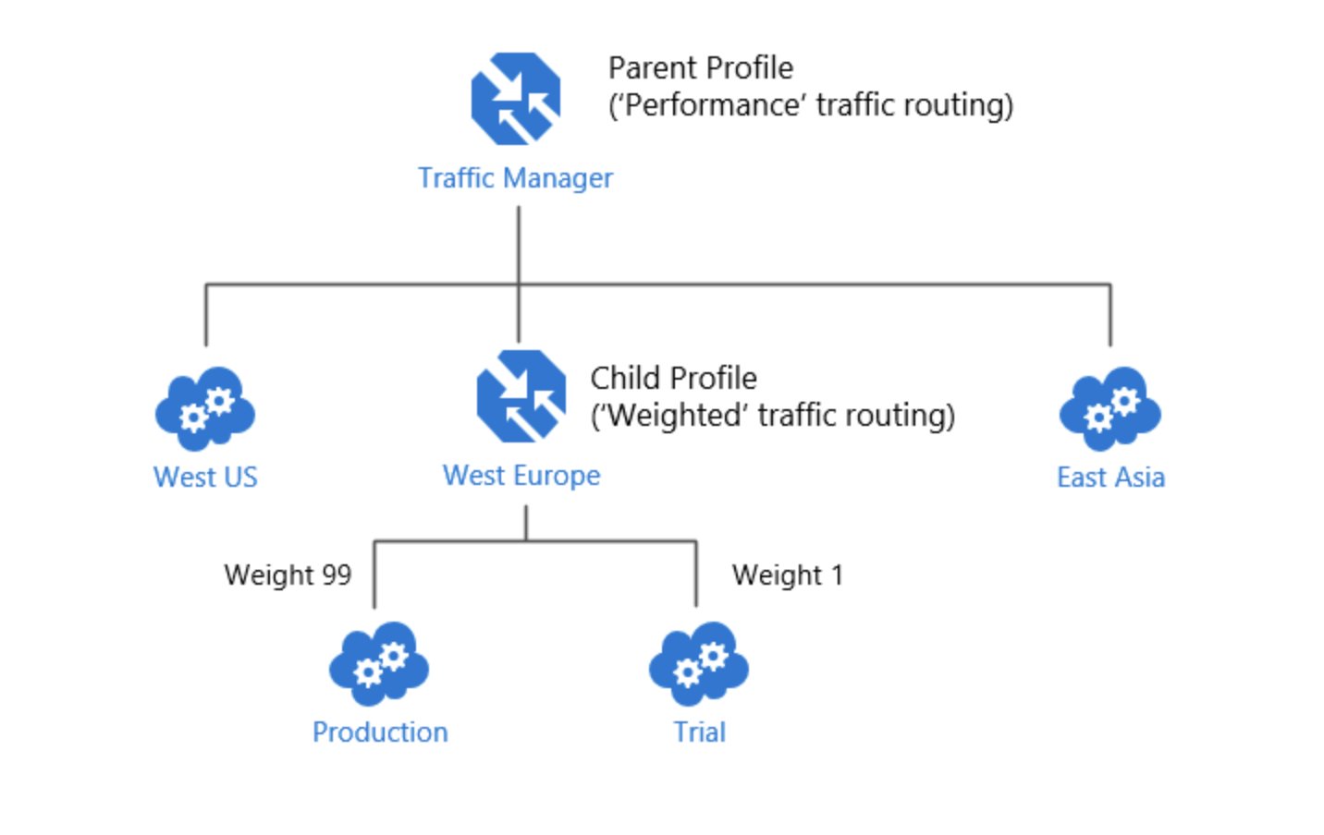
Example Nested Profiles – Combining Performance & Weighted Routing
deployed an application in the following Azure regions: West US, West Europe, and East Asia in Perf profile
Test and update before wide deployment – deployed only in WE region.
Only small traffic should come to the test update in WE
Can’t use perf. Create Child profile with Weighted routing

Slide 49
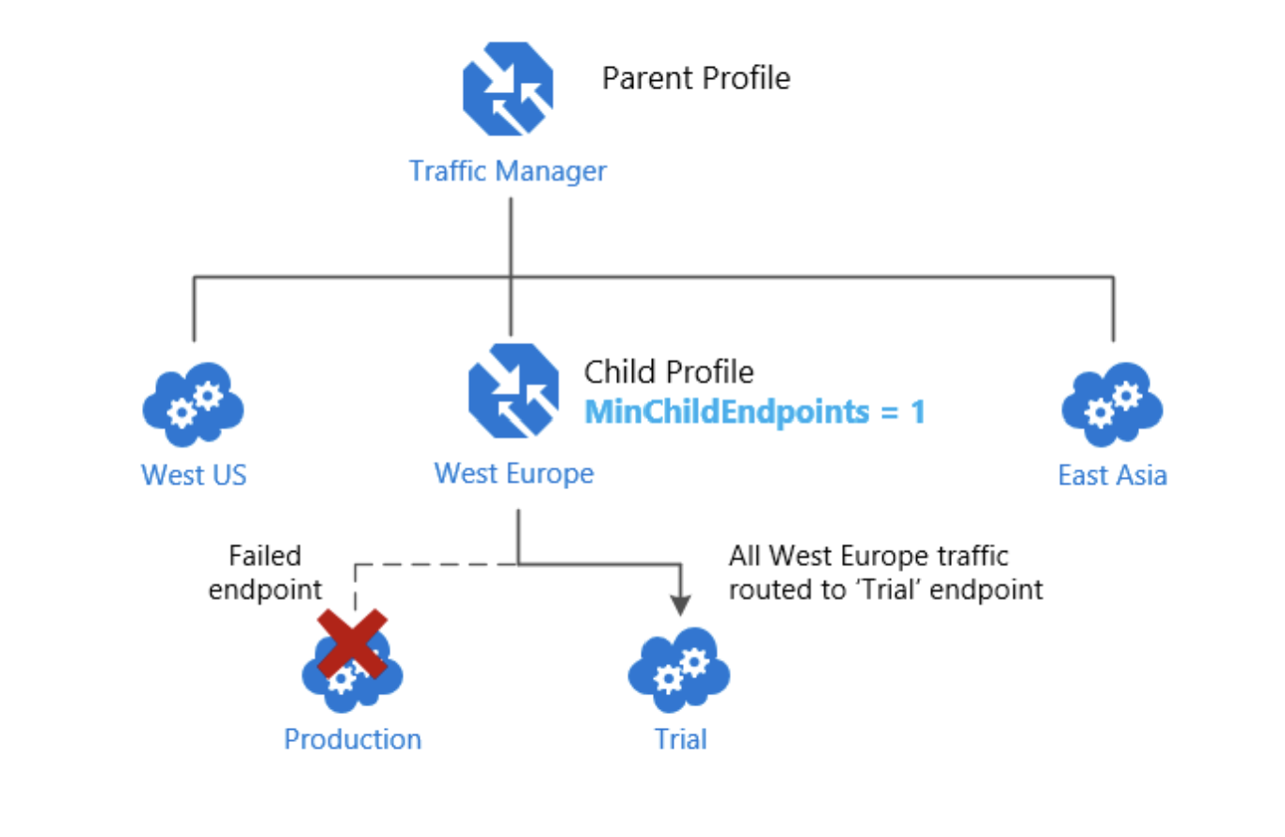
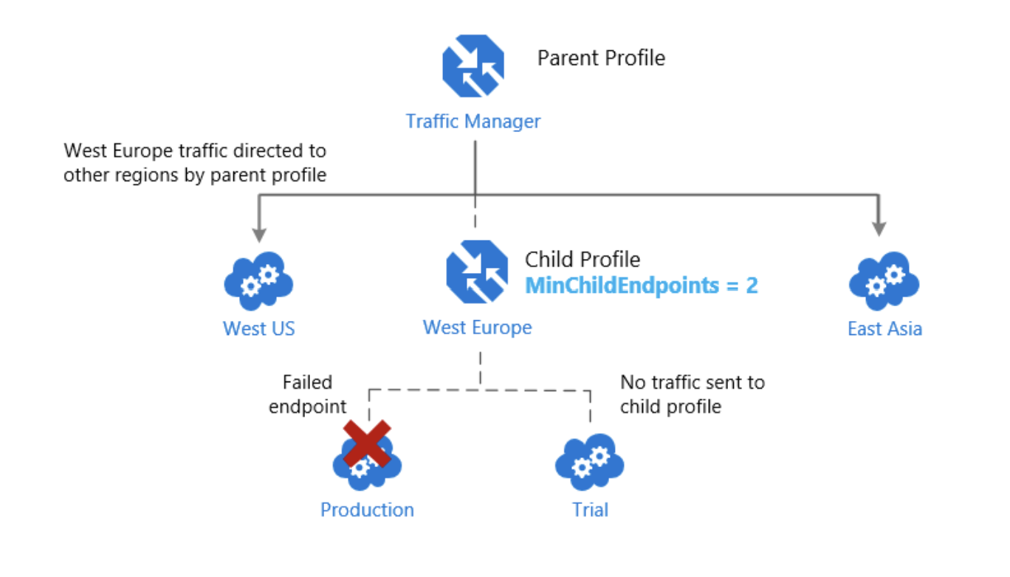
Nested Profiles – Endpoint monitoring
Is it okay to route all traffic to the trial deployment? If not, change the profile parameter value to 2
The parent profile will consider whole WE down because it needs minimum of 2 endpoints to consider it up and running.

Slide 50
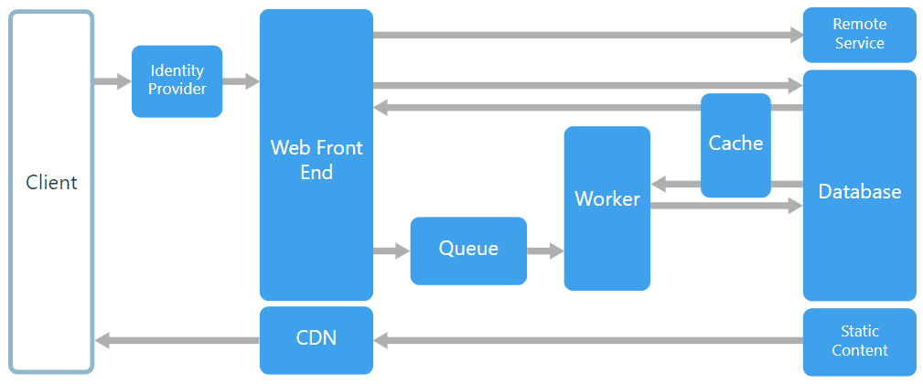
Web-Queue-Worker architecture

Slide 51
The core components of this architecture are
a web front end that serves client requests,
a worker that performs resource-intensive tasks, long-running workflows, or batch jobs.
a message queue - the web front end communicates with the worker through it.
Other components that are commonly incorporated into this architecture include:
One or more databases.
A cache to store values from the database for quick reads.
CDN to serve static content
Remote services, such as email or SMS service. Often these are provided by third parties.
Identity provider for authentication.

Slide 52
The web and worker are both stateless.
Session state can be stored in a distributed cache.
Any long-running work is done asynchronously by the worker.
The worker can be triggered by messages on the queue or run on a schedule for batch processing.
The worker is an optional component. If there are no long-running operations, the worker can be omitted.
The front end might consist of a web API.
On the client side, the web API can be consumed by a single-page application that makes AJAX calls, or by a native client application.

Slide 53
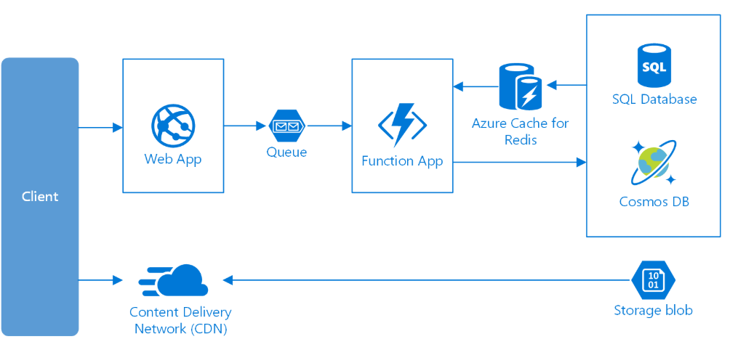
Web-Queue-Worker on Azure

Slide 54
Consider this architecture style for:
Applications with a relatively simple domain.
Applications with some long-running workflows or batch operations.
When you want to use managed services, rather than infrastructure as a service (IaaS).

Slide 55
Cloud Storage

Slide 56
Scenario: Disks & File system in cloud for VMs
VMs in cloud need disk drive for
Operating System
Temporary Data
Data storage
Applications running on VMs may also want to access files in a file system just like they do while running on actual h/w machine. Important for
cloud migration
shared file stores
developer tools etc.

Slide 57
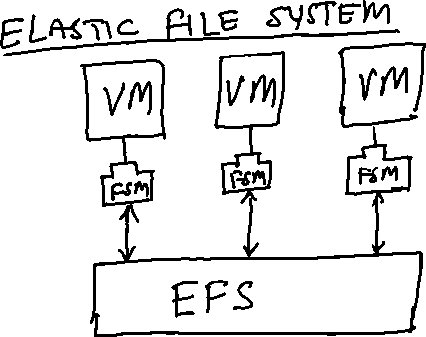


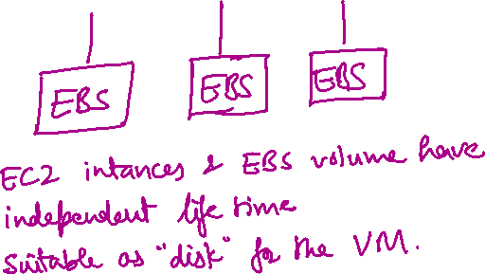



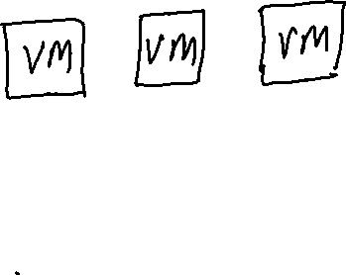

AWS Solution: EFS & EBS

Slide 58
Azure Solution: Azure Disks & Azure Files
Azure Files offers fully managed file shares in the cloud that are accessible via the Server Message Block (SMB) protocol.
ideal replacement for file shares on-premises
Azure file shares can be mounted concurrently by cloud or on-premises deployments of Windows, Linux, and macOS.
share a file system across multiple machines, applications/instances.
Azure file shares can be cached on Windows Servers with Azure File Sync for fast access near where the data is being used.
Azure Disks: OS disk, Temporary disk, Data disk. Unmanaged and Managed disks. Always use managed disks
Notes:
Unmanaged disks are the traditional type of disks that have been used by VMs.
Managed Disks handles the storage account creation/management in the background for you, and ensures that you do not have to worry about the scalability limits of the storage account. You simply specify the disk size and the performance tier (Standard/Premium), and Azure creates and manages the disk for you.

Slide 59
Scenario: Serving Static web content and media
Static web content typically include HTML pages and other resources like images, video and documents – scripts, pdf downloads etc.
Although web servers are well tuned to optimize requests through efficient dynamic page code execution and output caching, they still have to handle requests to download static content.
This means spending money on CPU cycles
GOAL: Minimise need for compute instances

Slide 60
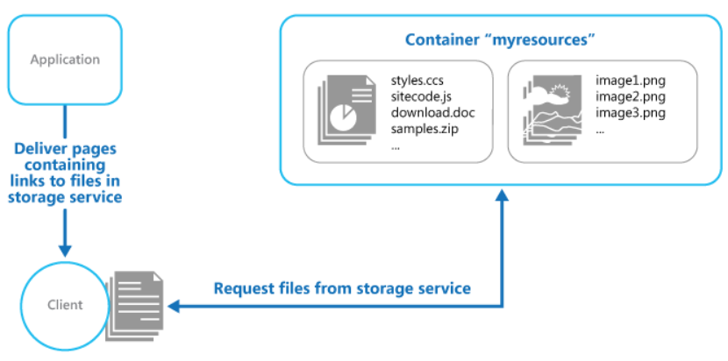
Solution: URL based storage service
Need to take care of –
Security
Read/Write access
Deployment

Slide 61
AWS Solution: Amazon S3 (Simple Storage Service)
Store data objects from 1 byte to 5 TB of data.
Each object has its public / access URL
Highly scalable – allows concurrent read and write access to data by many separate clients or application threads
In same region using S3 with EC2 instance (ie. a VM) is designed to be fast.
Can’t be used in place of file system
Can’t query data
Not suitable for very rapidly changing data
Better solutions available for archiving data
Not suitable for dynamic website hosting

